Slide 1
2018 Field Corn Weed Management Update
Eric P. Prostko
Professor/Extension Weed Specialist
Dept. Crop & Soil Sciences

Slide 2
Field Corn Weed Control - General
Other mgt. practices are important!
Tillage
Plant population
Row spacing
Nematode, insect, disease control
Irrigation
A healthy and uniformly spaced crop is better able to compete with weeds

Slide 3
Herbicide Carryover in GA?
Never say never but ……
low OM
high sand content
warm temperatures
ample rainfall/irrigation

Slide 4
Herbicide Carryover or Nematodes
Burke County
April 2017
Stubby Root Nematodes
21/100cm³ of soil
>9 is threshold

Slide 5
Figure 1. Field Corn Yield Loss (%) Caused by Uncontrolled Weeds in Georgia Weed Science Research Trials (2007-2017). Treated vs. Non-treated
200 Bu/A X 0.36 X $3.50 = $252/A
200 Bu/A X 0.16 X $3.50 = $112/A

Slide 6
Later POST Applications?
V6 stage
all leaves are initiated
Ear shoot initiation
Kernel rows/ear begins
Tassel initiation
Growing point above soil surface
~500 GDD

Slide 7
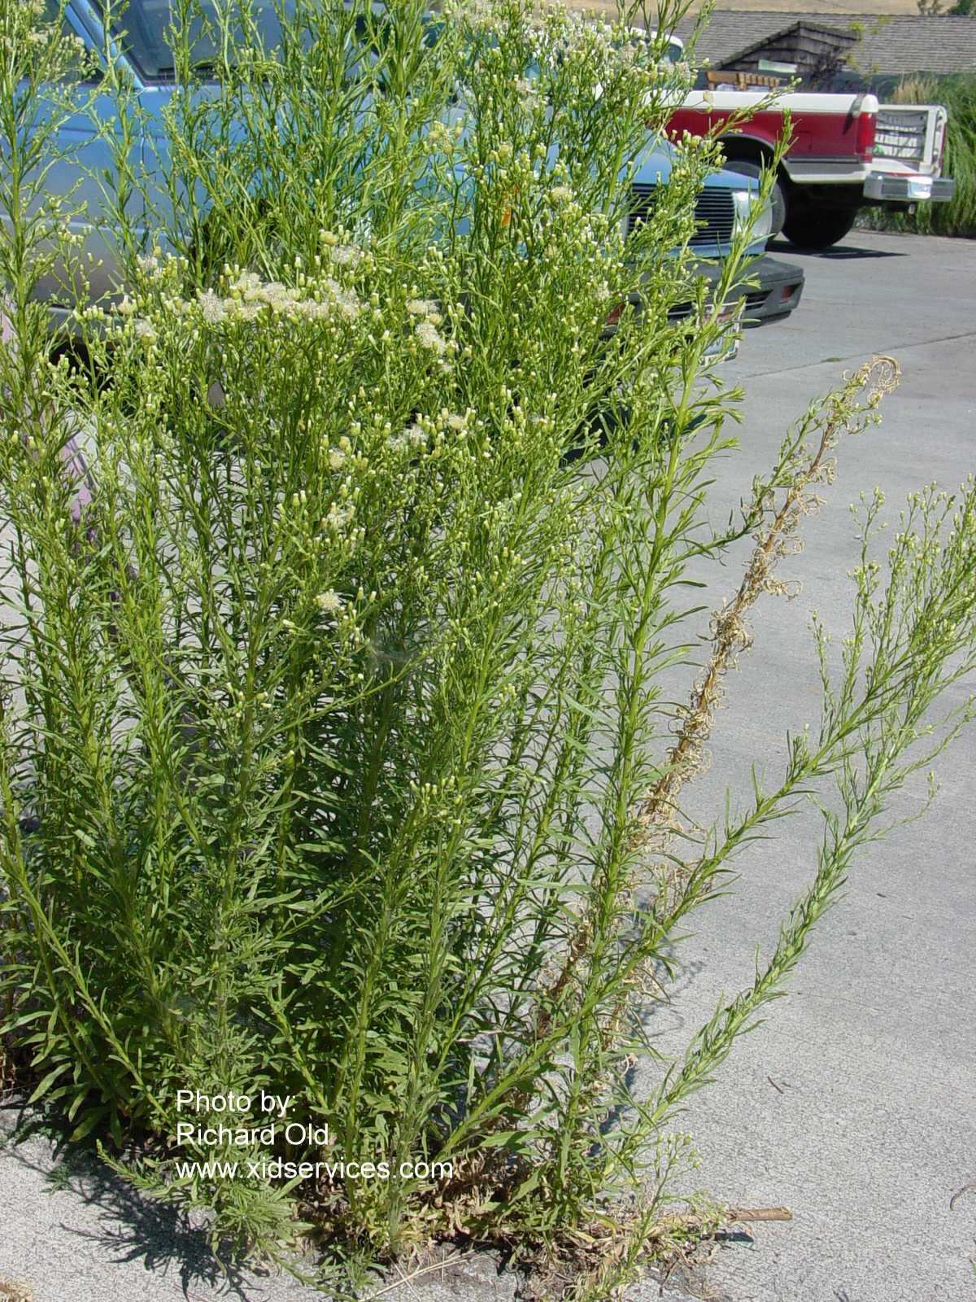
Marestail in Field Corn (i.e. Horseweed)
Tillage
Burndown
Liberty (glufosinate)
+ atrazine?
Glyphosate +
Dicamba or 2,4-D?
Sharpen + MSO
0 day plant-back
Paraquat + atrazine
Residual
atrazine
In-Crop
Liberty (LL)
Dicamba
2,4-D
Enlist corn - 2,4-D choline

Slide 8
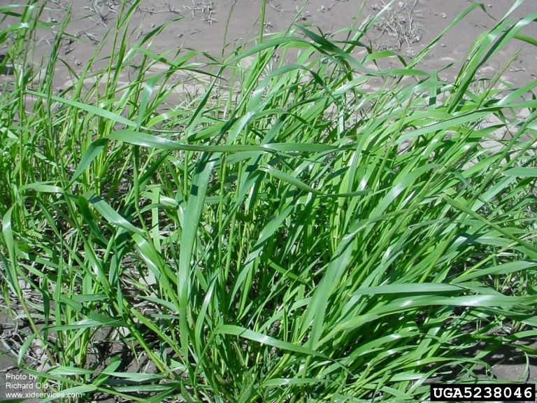
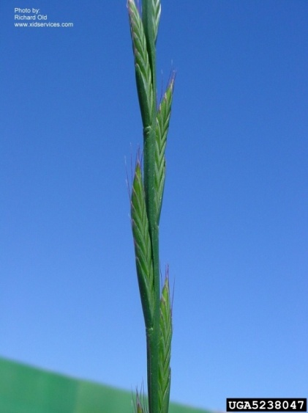
Ryegrass Control
Glyphosate-resistant or not?
Fall (mid-October – Mid-November)
Tillage (double disk) or
Dual Magnum @ 1.33 pt/A
Mid-January – Mid-February
2” - 6” tall
Select Max 0.97EC @ 6 oz/A or Clethodim 2EC @ 6-8 oz/A
Corn – 30 DBP
Nighttime temps > 47⁰ F
March 1-20
Gramoxone 2SL @ 3-4 pt/A
May need 2 applications (10-14 days apart)
+ atrazine @ 1 qt/A
Source: Dr. Jason Bond, MS State University

Slide 9
Field Corn Weed Control - 2017
NTC
Roundup P-Max @ 32 oz/A
Atrazine @ 64 oz/A
Prowl H₂O @ 32 oz/A
CN-02-17
April 27
13 DAT

Slide 10
Late-Season Weed Control
NTC
Roundup P-Max @ 32 oz/A
Atrazine 4L @ 64 oz/A
Prowl H₂0 @ 32 oz/A
Applied 17 DAP
CN-02-17
July 24
118 DAP

Slide 11
Field Corn Weed Control - 2017
NTC
Liberty @ 29 oz/A
Atrazine @ 64 oz/A
Prowl H₂0 @ 32 oz/A
CN-02-17
April 27
13 DAT

Slide 12
Field Corn Weed Control - 2017
NTC
Halex GT @ 58 oz/A
Atrazine @ 64 oz/A
Adept @ 0.25% v/v
CN-02-17
April 27
13 DAT

Slide 13
Normal Halex GT Injury
CN-05-17
April 24
7 DAT

Slide 14
Field Corn Weed Control - 2017
NTC
Revulin Q @ 3.4 oz/A
Atrazine @ 64 oz/A
Adept @ 0.25% v/v
CN-02-17
April 27
13 DAT

Slide 15
Field Corn Weed Control - 2017
NTC
Laudis @ 3 oz/A
Atrazine @ 64 oz/A
MES 100 @ 1% v/v
CN-02-17
April 27
13 DAT

Slide 16
Morningglory Control in Field Corn

Slide 17
Morningglory Control in Corn
as much atrazine as possible
1.0 lb/A – PRE fb 1.5 lb/A – POST
small grain rotations
2,4-D, Clarity, Status, Aim, ET, Evik (PDIR)
Enlist Corn???
Liberty-Link® Corn Systems
split applications of glyphosate (RR corn)
* 1st application + atrazine
Harvest Aids
Aim
Early-harvest

Slide 18
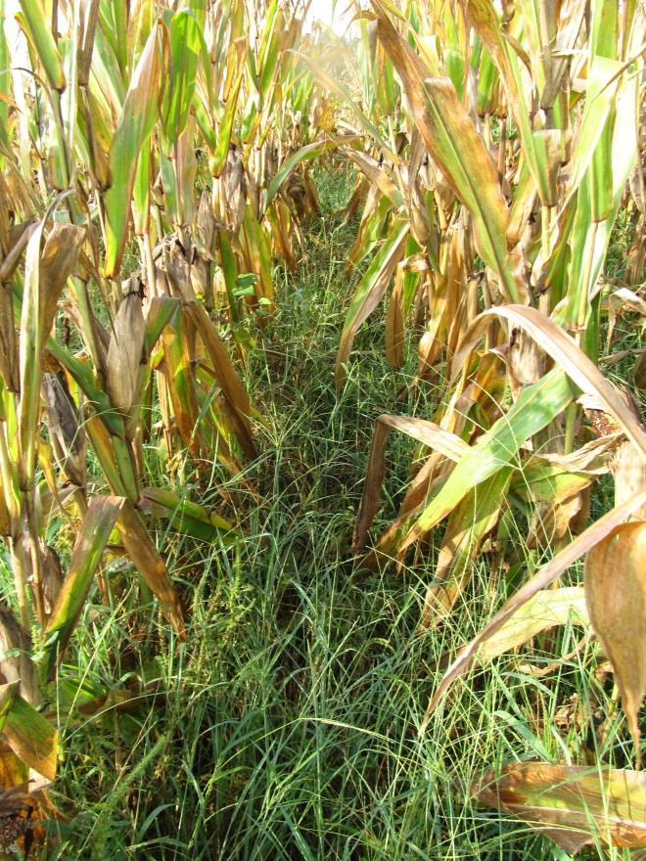
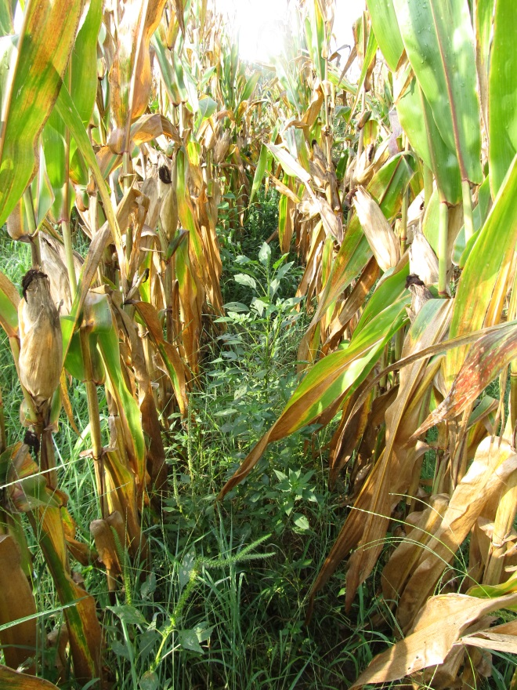
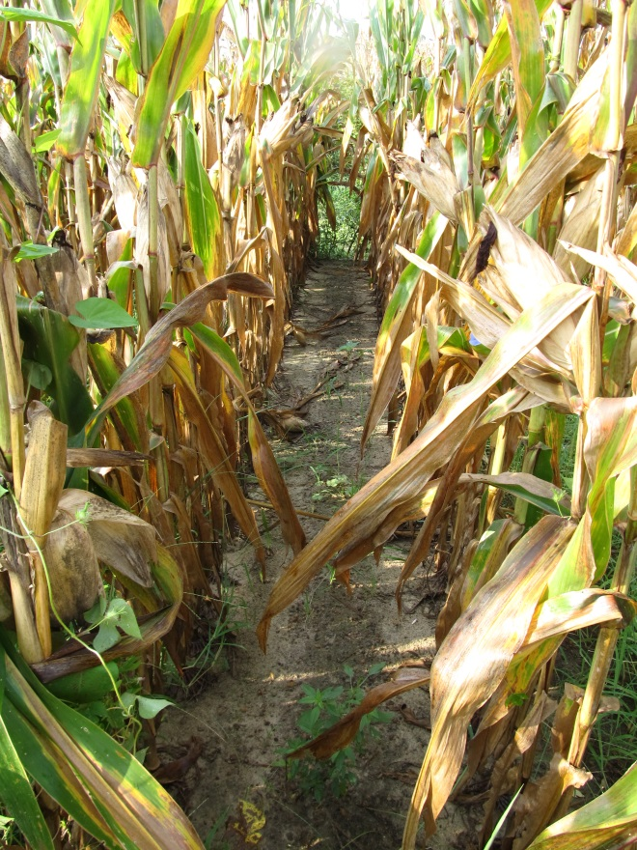
Do we need to rethink laybys????
NTC
Atrazine 4L @ 32 oz/A (PRE)
Roundup WM @ 32 oz/A +
Atrazine @ 48 oz/A (21 DAP)
Atrazine 4L @ 32 oz/A (PRE)
Roundup WM @ 32 oz/A +
Atrazine @ 48 oz/A (21 DAP)
Evik @ 2 lb/A + NIS (37 DAP)
CN-06-15
July 29
133 DAP

Slide 19
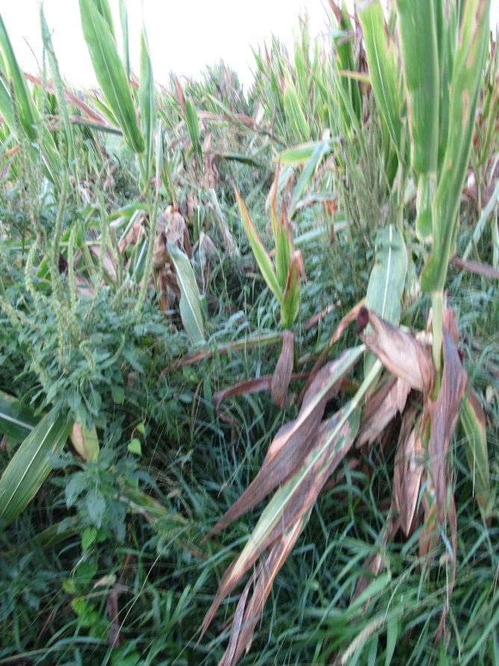
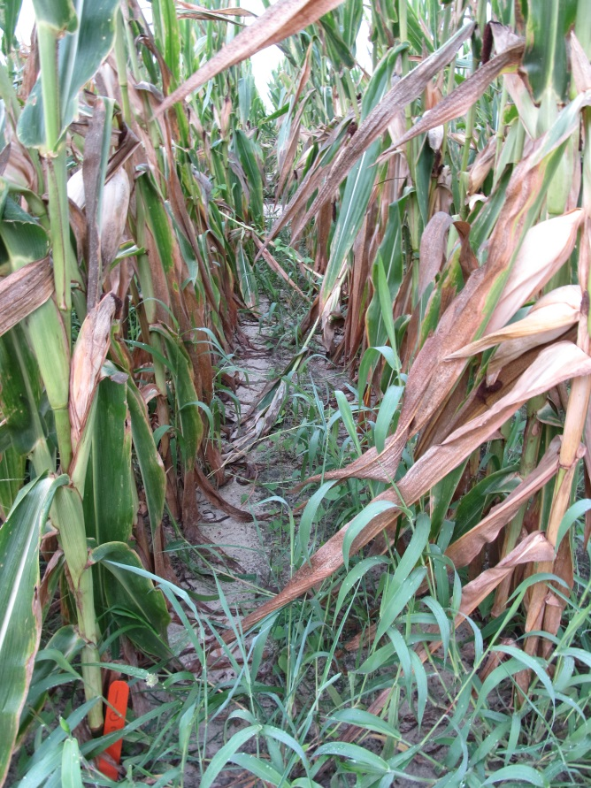
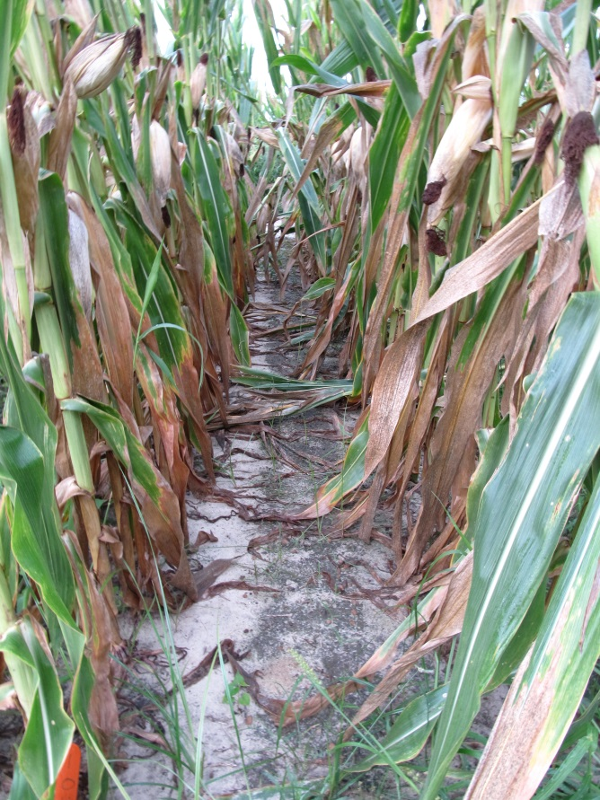
Evik or Not?
NTC
Atrazine 4L @ 32 oz/A (PRE)
Roundup P-Max 5.5SL @ 32 oz/A (POST)
Atrazine 4L @ 48 oz/A (POST)
Atrazine 4L @ 32 oz/A (PRE)
Roundup P-Max 5.5SL @ 32 oz/A (POST)
Atrazine 4L @ 48 oz/A (POST)
Evik 80DG @ 2 lbs/A (PDIR)
NIS @ 0.25% v/v (PDIR)
CN-01-16
July 7
108 DAP

Slide 20
What herbicides can you use in field corn if you have resistance to glyphosate, atrazine, and/or ALS herbicides?
Residuals
Zidua
Dual Magnum
Warrant
Prowl
Postemergence*
Liberty
Status
Revulin Q
Impact/Armezon
Laudis
Capreno
Halex GT
2,4-D
* double-crop soybean rotations?

Slide 21
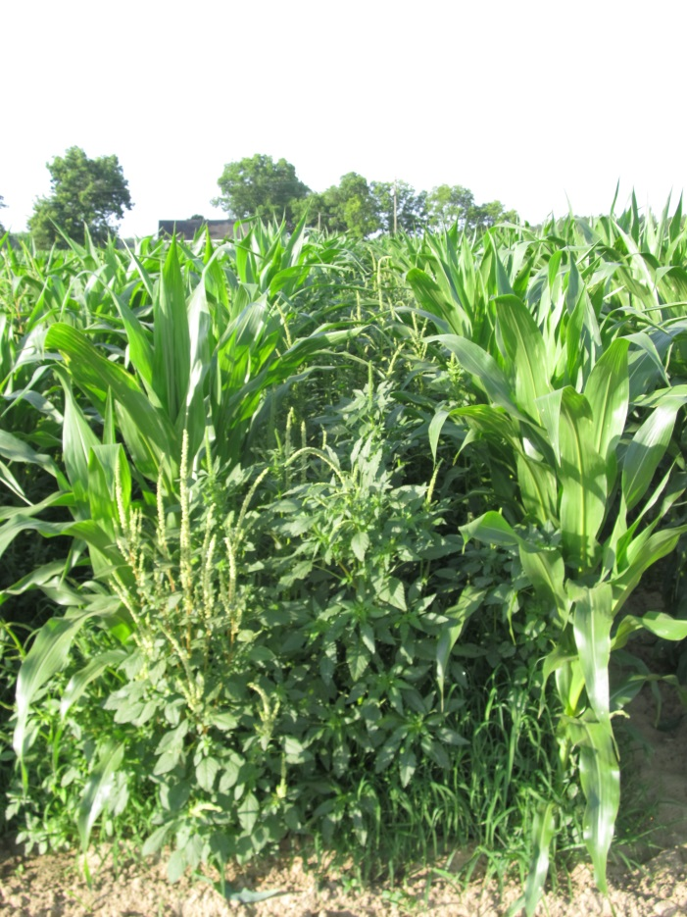
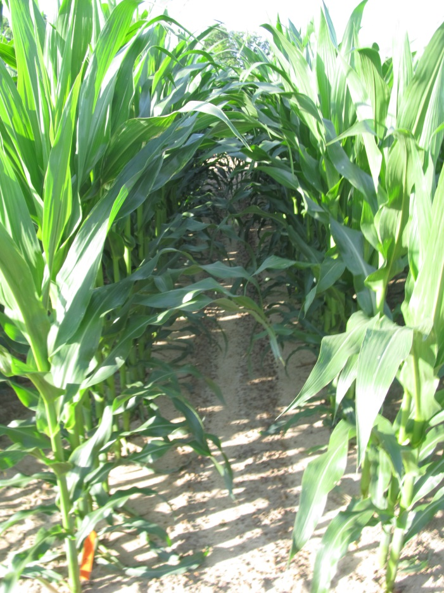
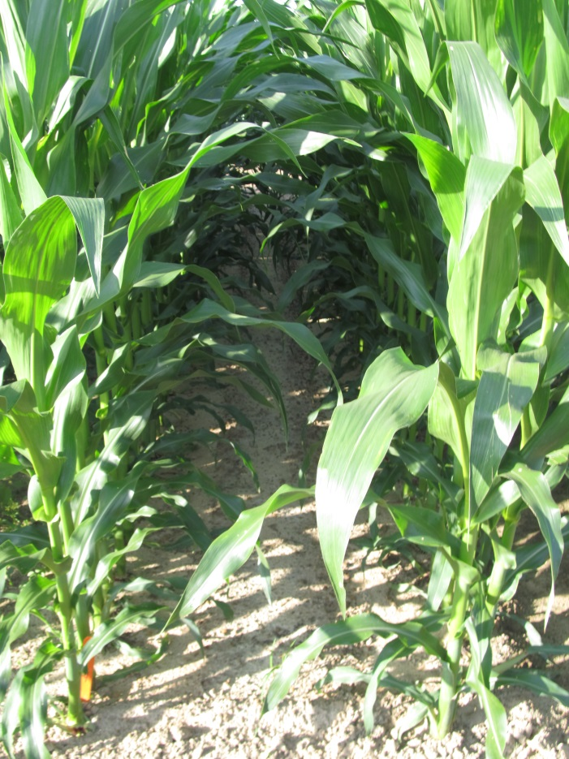
Field Corn Weed Control Without Atrazine or Glyphosate - 2017
NTC
(209 Bu/A)
Dual II Magnum @ 16 oz/A (PRE)
Laudis @ 3 oz/A (28 DAP)
COC @ 1% v/v (28 DAP)
AMS Xtra @ 2.5% v/v (28 DAP)
(251 Bu/A)
Warrant @ 48 oz/A (PRE)
Laudis @ 3 oz/A (28 DAP)
COC @ 1% v/v (28 DAP)
AMS Xtra @ 2.5% v/v (28 DAP)
(247 Bu/A)
CN-03-17
May 18
51 DAP
DKC 66-59

Slide 22
New (er) Stuff

Slide 23
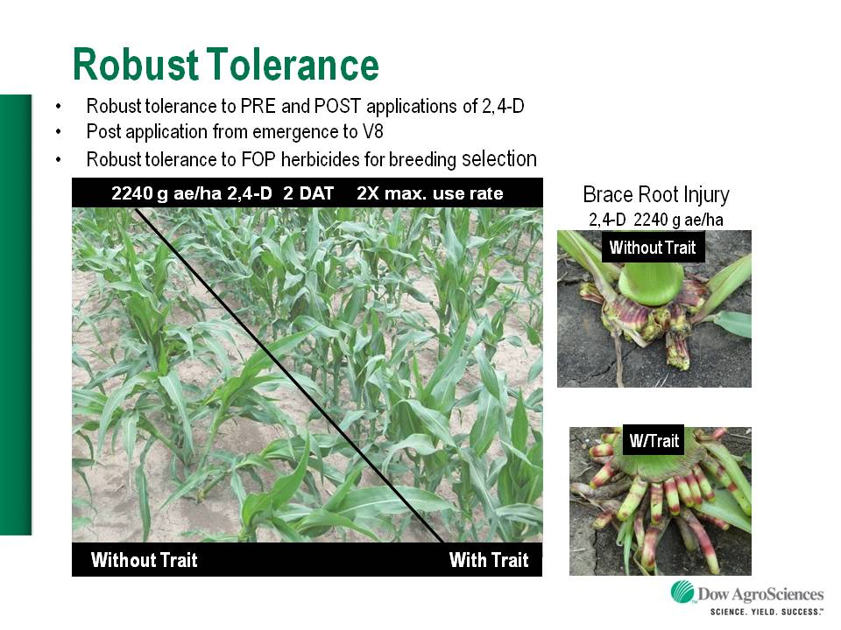
Enlist™ Herbicide Tolerant Corn
tolerance to 2,4-D and Assure + GLY
Trait was deregulated in September 2014 and herbicide in October 2014. U.S. launch in 2018 (SE??).
Colex-D™ technology
2,4-D choline
lower volatility
lower drift potential
enhanced handling/mixing characteristics
reduced odor
1 PRE application + 2 POST applications (30” or V8 stage)
Enlist™ Duo
DMA-Glyphosate (1.71 lb ae/gal) + 2,4-D choline (1.63 lb ae/gal)
Enlist™ One
2,4-D choline (3.8 lb ae/gal)
2,4-D choline

Slide 24
Enlist™ Field Corn Hybrids - 2018
China approval
June 2017
Limited or no data for SE?????
Broadbeck
Dairyland
Mycogen
Pfister
Prairie Brand

Slide 25
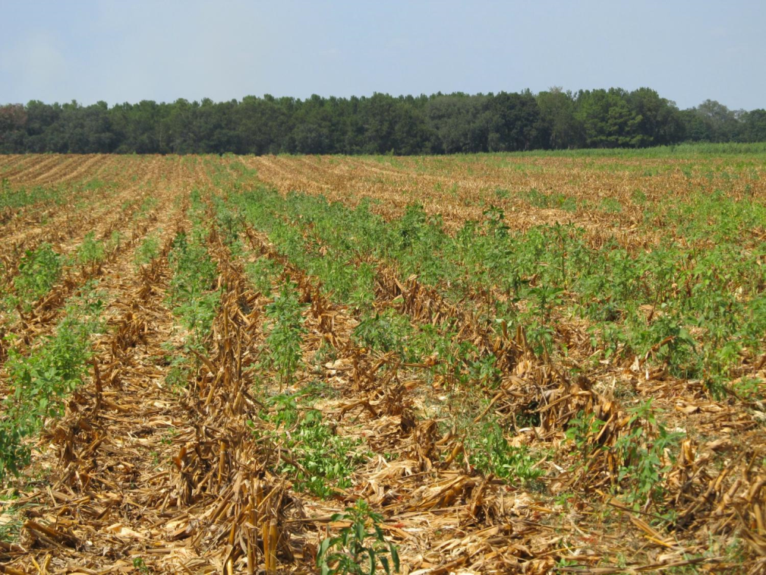
Post-Harvest
Palmer amaranth
tropical spiderwort
Benghal dayflower

Slide 26
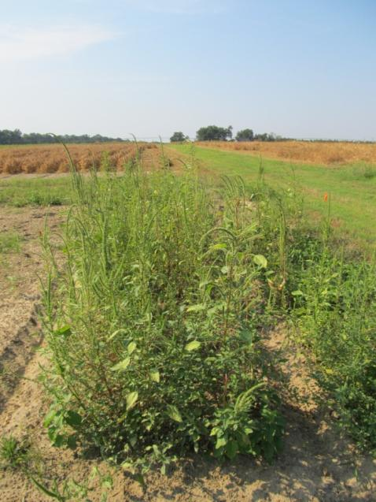
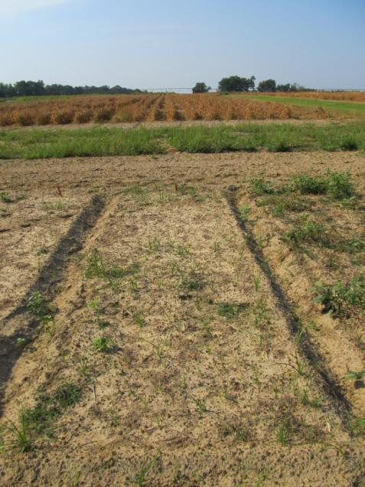
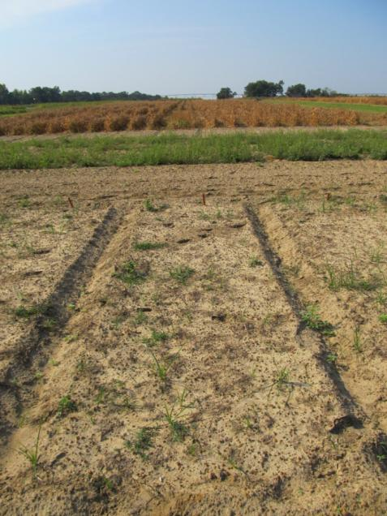
Post-Harvest Control of Palmer Amaranth (8.1” average: 2”-17” range at application)
NTC
Gramoxone Inteon 2SL @ 3 pt/A
2,4-D Amine 3.8SL @ 1 pt/A
Primary @ 1% v/v
Gramoxone Inteon 2SL @ 3 pt/A
Clarity 4SL @ 8 oz/A
Primary @ 1% v/v
CN-01B-11
September 15
30 DAT

Slide 27
Post-Harvest Control of Tropical Spiderwort
Untreated
Gramoxone
POST1 + POST2
POST1: 8-10” tall COMBE
POST2: 2 weeks later
Photo 1 week after POST2

Slide 28
Questions/Comments?

